Slide 1
Urdu Gazal Aura Taswore Ishq
اردو غزل اور تصور عشق
Dr.Sabiha Sameeroddin Sayed
Head Of The Department Urdu
Night College of Arts & Commerce Ichalkaranji ,Dist.Kolhapur

Slide 2
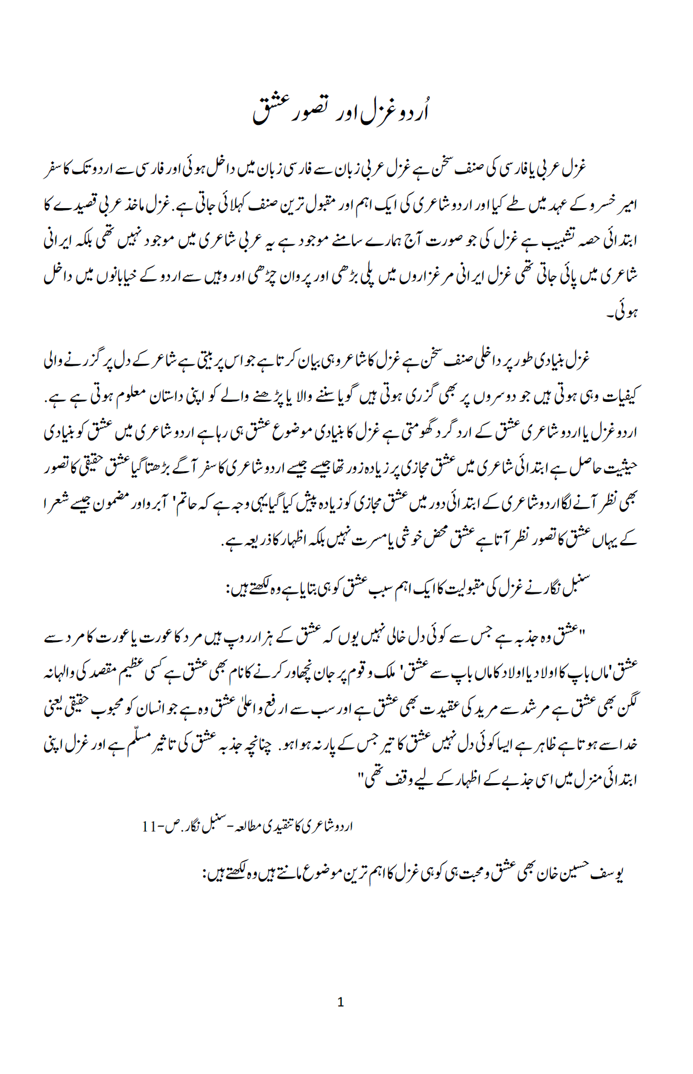

Slide 3
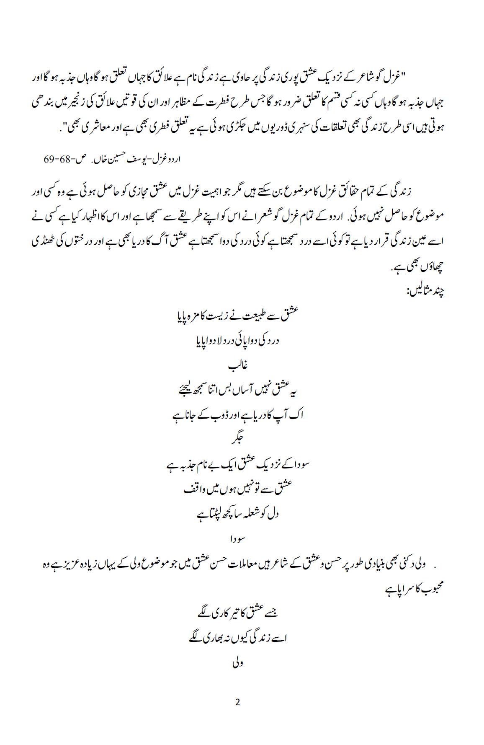

Slide 4
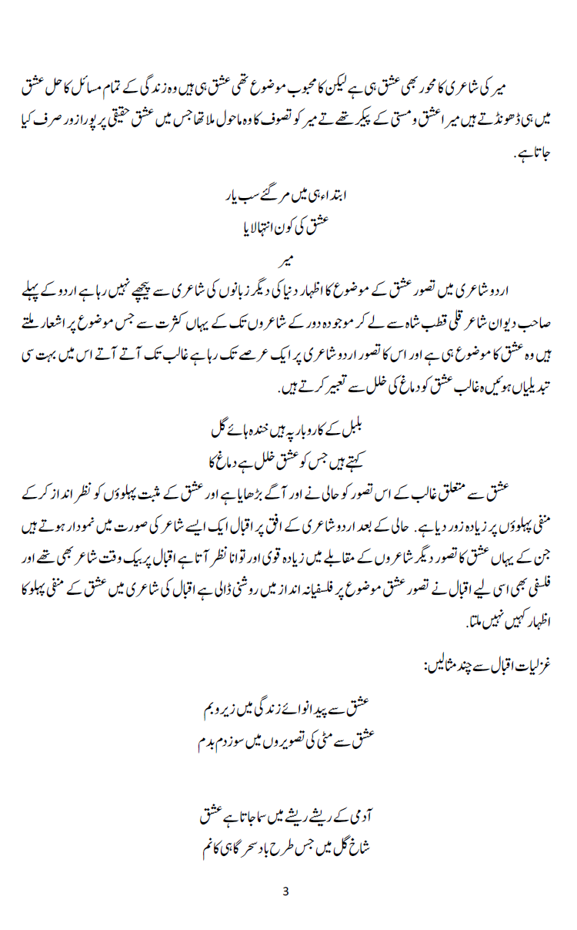

Slide 5
